Slide 1
Bayes’ Rule
Given two events A and B and suppose that Pr(A) > 0. Then
Example:
Pr(R) = 0.8
R: It is a rainy day
W: The grass is wet
Pr(R|W) = ?
Pr(W|R) | R | ¬R
W | 0.7 | 0.4
¬W | 0.3 | 0.6

Slide 2
Bayes’ Rule
 | R | ¬R
W | 0.7 | 0.4
¬W | 0.3 | 0.6
R: It rains
W: The grass is wet
Information
Pr(W|R)
R
W
Inference
Pr(R|W)

Slide 3
Bayes’ Rule
 | R | ¬R
W | 0.7 | 0.4
¬W | 0.3 | 0.6
R: It rains
W: The grass is wet
Information: Pr(E|H)
Hypothesis H
Evidence E
Posterior
Likelihood
Prior
Inference: Pr(H|E)

Slide 4
Bayes’ Rule: More Complicated
Suppose that B₁, B₂, … B_{k} form a partition of S:
Suppose that Pr(B_{i}) > 0 and Pr(A) > 0. Then

Slide 5
Bayes’ Rule: More Complicated
Suppose that B₁, B₂, … B_{k} form a partition of S:
Suppose that Pr(B_{i}) > 0 and Pr(A) > 0. Then

Slide 6
Bayes’ Rule: More Complicated
Suppose that B₁, B₂, … B_{k} form a partition of S:
Suppose that Pr(B_{i}) > 0 and Pr(A) > 0. Then

Slide 7
A More Complicated Example
R | It rains
W | The grass is wet
U | People bring umbrella
Pr(UW|R)=Pr(U|R)Pr(W|R) Pr(UW| ¬R)=Pr(U| ¬R)Pr(W| ¬R)
R
W
U
Pr(R) = 0.8
Pr(W|R) | R | ¬R
W | 0.7 | 0.4
¬W | 0.3 | 0.6
Pr(U|R) | R | ¬R
U | 0.9 | 0.2
¬U | 0.1 | 0.8
Pr(U|W) = ?

Slide 8
A More Complicated Example
R | It rains
W | The grass is wet
U | People bring umbrella
Pr(UW|R)=Pr(U|R)Pr(W|R) Pr(UW| ¬R)=Pr(U| ¬R)Pr(W| ¬R)
R
W
U
Pr(R) = 0.8
Pr(W|R) | R | ¬R
W | 0.7 | 0.4
¬W | 0.3 | 0.6
Pr(U|R) | R | ¬R
U | 0.9 | 0.2
¬U | 0.1 | 0.8
Pr(U|W) = ?

Slide 9
A More Complicated Example
R | It rains
W | The grass is wet
U | People bring umbrella
Pr(UW|R)=Pr(U|R)Pr(W|R) Pr(UW| ¬R)=Pr(U| ¬R)Pr(W| ¬R)
R
W
U
Pr(R) = 0.8
Pr(W|R) | R | ¬R
W | 0.7 | 0.4
¬W | 0.3 | 0.6
Pr(U|R) | R | ¬R
U | 0.9 | 0.2
¬U | 0.1 | 0.8
Pr(U|W) = ?

Slide 10
Random Variable and Distribution
A random variable X is a numerical outcome of a random experiment
The distribution of a random variable is the collection of possible outcomes along with their probabilities:
Discrete case:
Continuous case:

Slide 11
Random Variable: Example
Let S be the set of all sequences of three rolls of a die. Let X be the sum of the number of dots on the three rolls.
What are the possible values for X?
Pr(X = 5) = ?, Pr(X = 10) = ?

Slide 12
Expectation
A random variable X~Pr(X=x). Then, its expectation is
In an empirical sample, x1, x2,…, xN,
Continuous case:
Expectation of sum of random variables

Slide 13
Expectation: Example
Let S be the set of all sequence of three rolls of a die. Let X be the sum of the number of dots on the three rolls.
What is E(X)?
Let S be the set of all sequence of three rolls of a die. Let X be the product of the number of dots on the three rolls.
What is E(X)?

Slide 14
Variance
The variance of a random variable X is the expectation of (X-E[x])² :

Slide 15
Bernoulli Distribution
The outcome of an experiment can either be success (i.e., 1) and failure (i.e., 0).
Pr(X=1) = p, Pr(X=0) = 1-p, or
E[X] = p, Var(X) = p(1-p)

Slide 16
Binomial Distribution
n draws of a Bernoulli distribution
X_{i}~Bernoulli(p), X=∑_{i=1}^{n} X_{i}, X~Bin(p, n)
Random variable X stands for the number of times that experiments are successful.
E[X] = np, Var(X) = np(1-p)

Slide 17
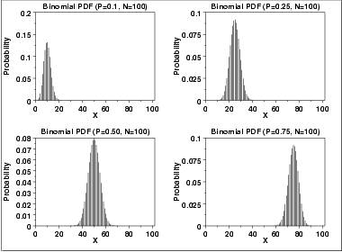
Plots of Binomial Distribution

Slide 18
Poisson Distribution
Coming from Binomial distribution
Fix the expectation λ=np
Let the number of trials n→∞
A Binomial distribution will become a Poisson distribution
E[X] = λ, Var(X) = λ

Slide 19
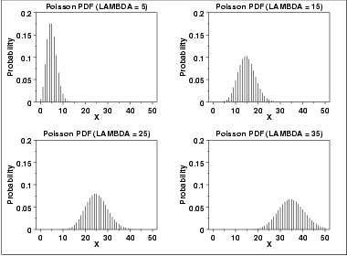
Plots of Poisson Distribution

Slide 20
Normal (Gaussian) Distribution
X~N(μ,σ)
E[X]= μ, Var(X)= σ²
If X₁~N(μ₁,σ₁) and X₂~N(μ₂,σ₂), X= X₁+ X₂ ?

